Slide 1





Young Scientists in an Age of Knowledge Neocolonialism and Surveillance Capitalism
Peter Murray-Rust
Yusuf Hamied Dept of Chemistry,
University of Cambridge
Jamia Hamdard
Delhi, IN, 2024-02-29
Let’s build a modern Open knowledgebase
which we, not megacorporations, control

Slide 2
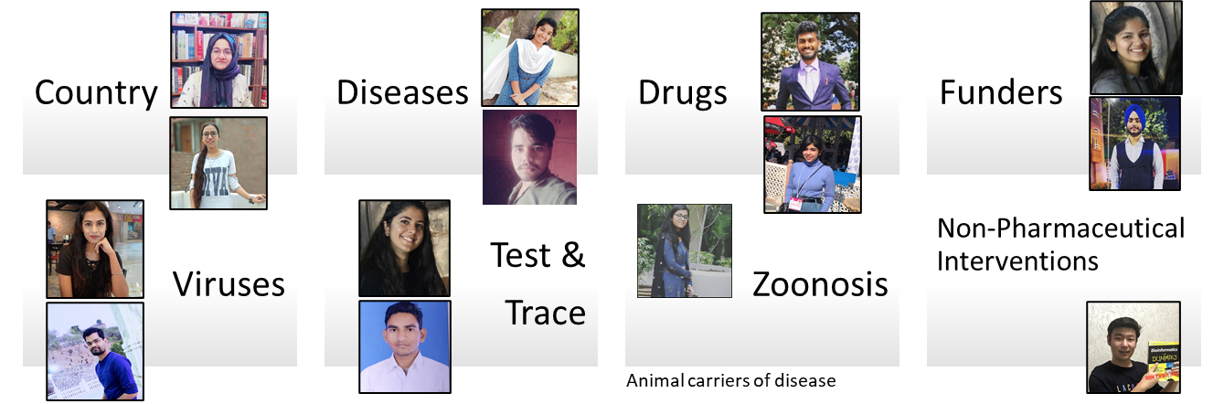
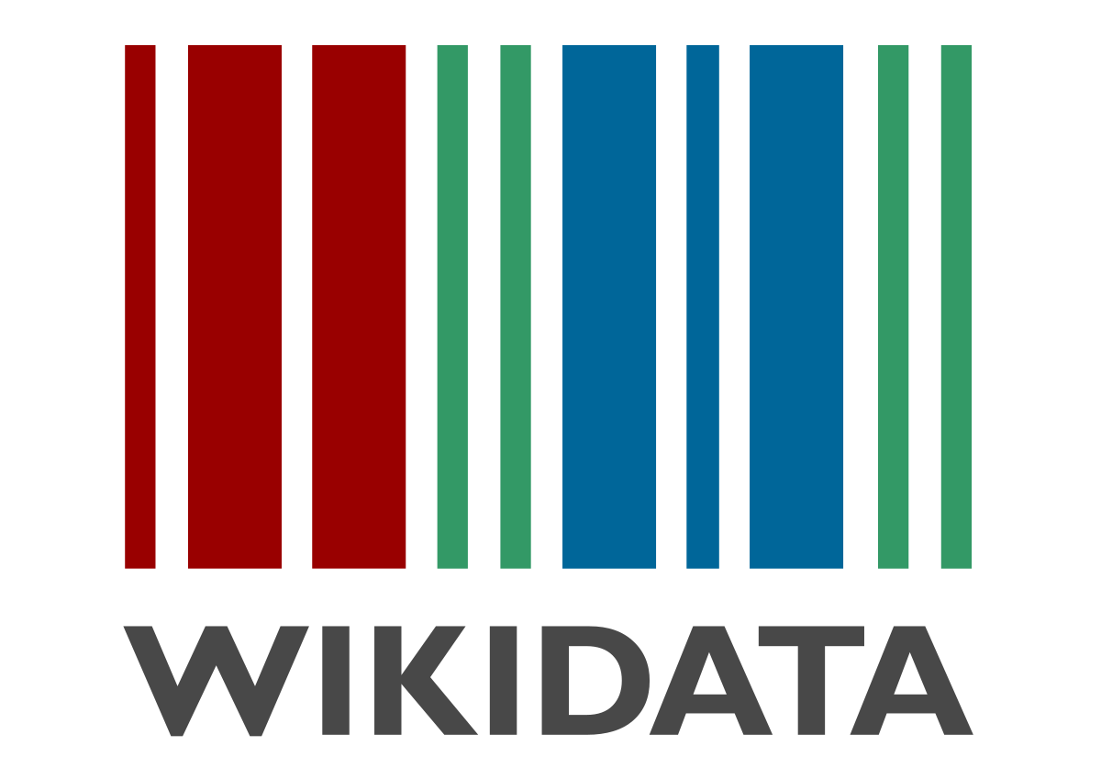



Initial project (OpenVirus) 2021
Multilingual!
Slide Credits: Ambreen Hamadani
Credits: MS PowerPoint 3D Models; Wikipedia (https://en.wikipedia.org)
Notes:
Wikidata and Wikipedia globe
Slide for minicopus
Image of the people involved in each project
Numbers if we do not limit the search
Picture of local machines

Slide 3
Opening Knowledge overcomes injustice
Open comes from the heart.
Closed Access Means People Die.
Megacorporations are pwning the knowledge infrastructure/
The Right to Read is the Right to Mine
Young people change the world. Give them the chance.
ACT: Advocacy , Community, Tools

Slide 4
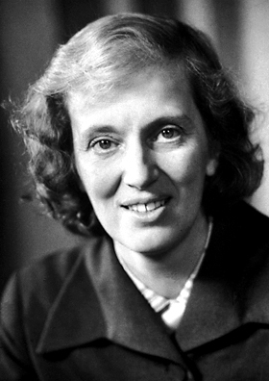
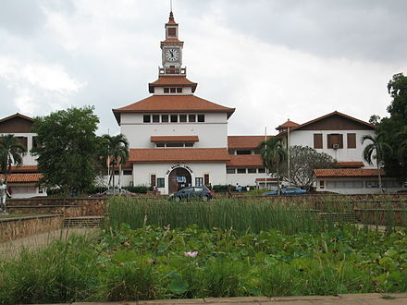
My gratitude to Dorothy Hodgkin, mentor
and Ghana/Ghanaians 1963-1965
Dorothy
Hodgkin
(Nobel Laureate, Oxford, Ghana and the whole world
University of Ghana, Legon, Accra, Ghana
Images: Wikimedia Commons

Slide 5
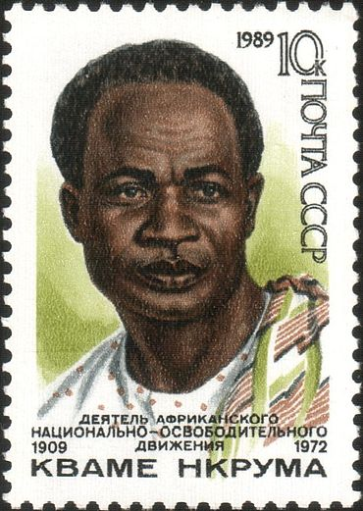
Neocolonialism
In place of colonialism, as the main instrument of imperialism, we have today neo-colonialism . . . [which] like colonialism, is an attempt to export the social conflicts of the capitalist countries. . . .
The result of neo-colonialism is that foreign capital is used for the exploitation rather than for the development of the less developed parts of the world. Investment, under neo-colonialism, increases, rather than decreases, the gap between the rich and the poor countries of the world. The struggle against neo-colonialism is not aimed at excluding the capital of the developed world from operating in less developed countries. It is aimed at preventing the financial power of the developed countries being used in such a way as to impoverish the less developed.[5]
Kwame Nkrumah 1965 Neo-Colonialism, The Last Stage of Imperialism.
Text and Image: Wikimedia Commons

Slide 6
Knowledge Neocolonialism/Capitalism
The result of [knowledge colonialism] is that [corporate] capital is used for the exploitation rather than for the development of the less developed parts of the [knowledge] world.
Investment, under [knowledge imperialism], increases, rather than decreases, the gap between the rich and the poor [scholars] of the world. The struggle against [knowledge neocolonialism] […] is aimed at preventing the financial power of the [megacorporations] being used in such a way as to impoverish the less developed.[5]
(adapted by PMR from Kwame Nkrumah) s/country/scholar/, s/colonial power/megacorporation/

Slide 7
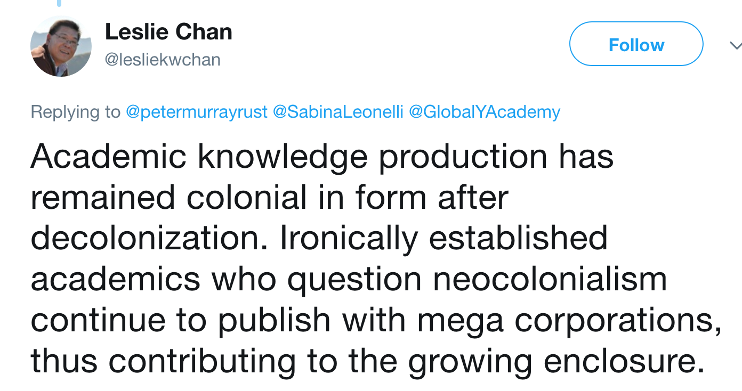
Immediate reply from Leslie Chan

Slide 8
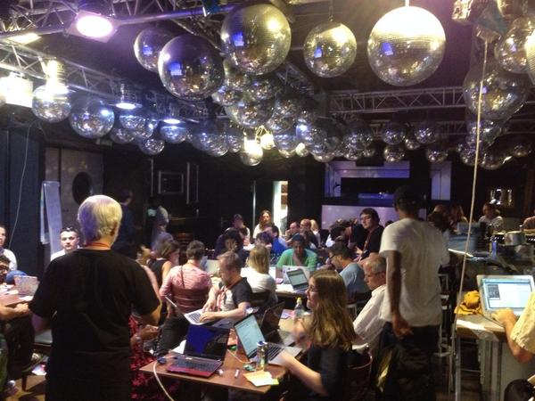
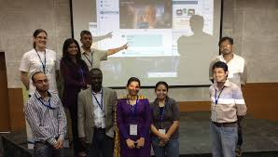
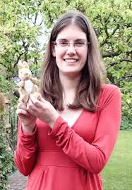
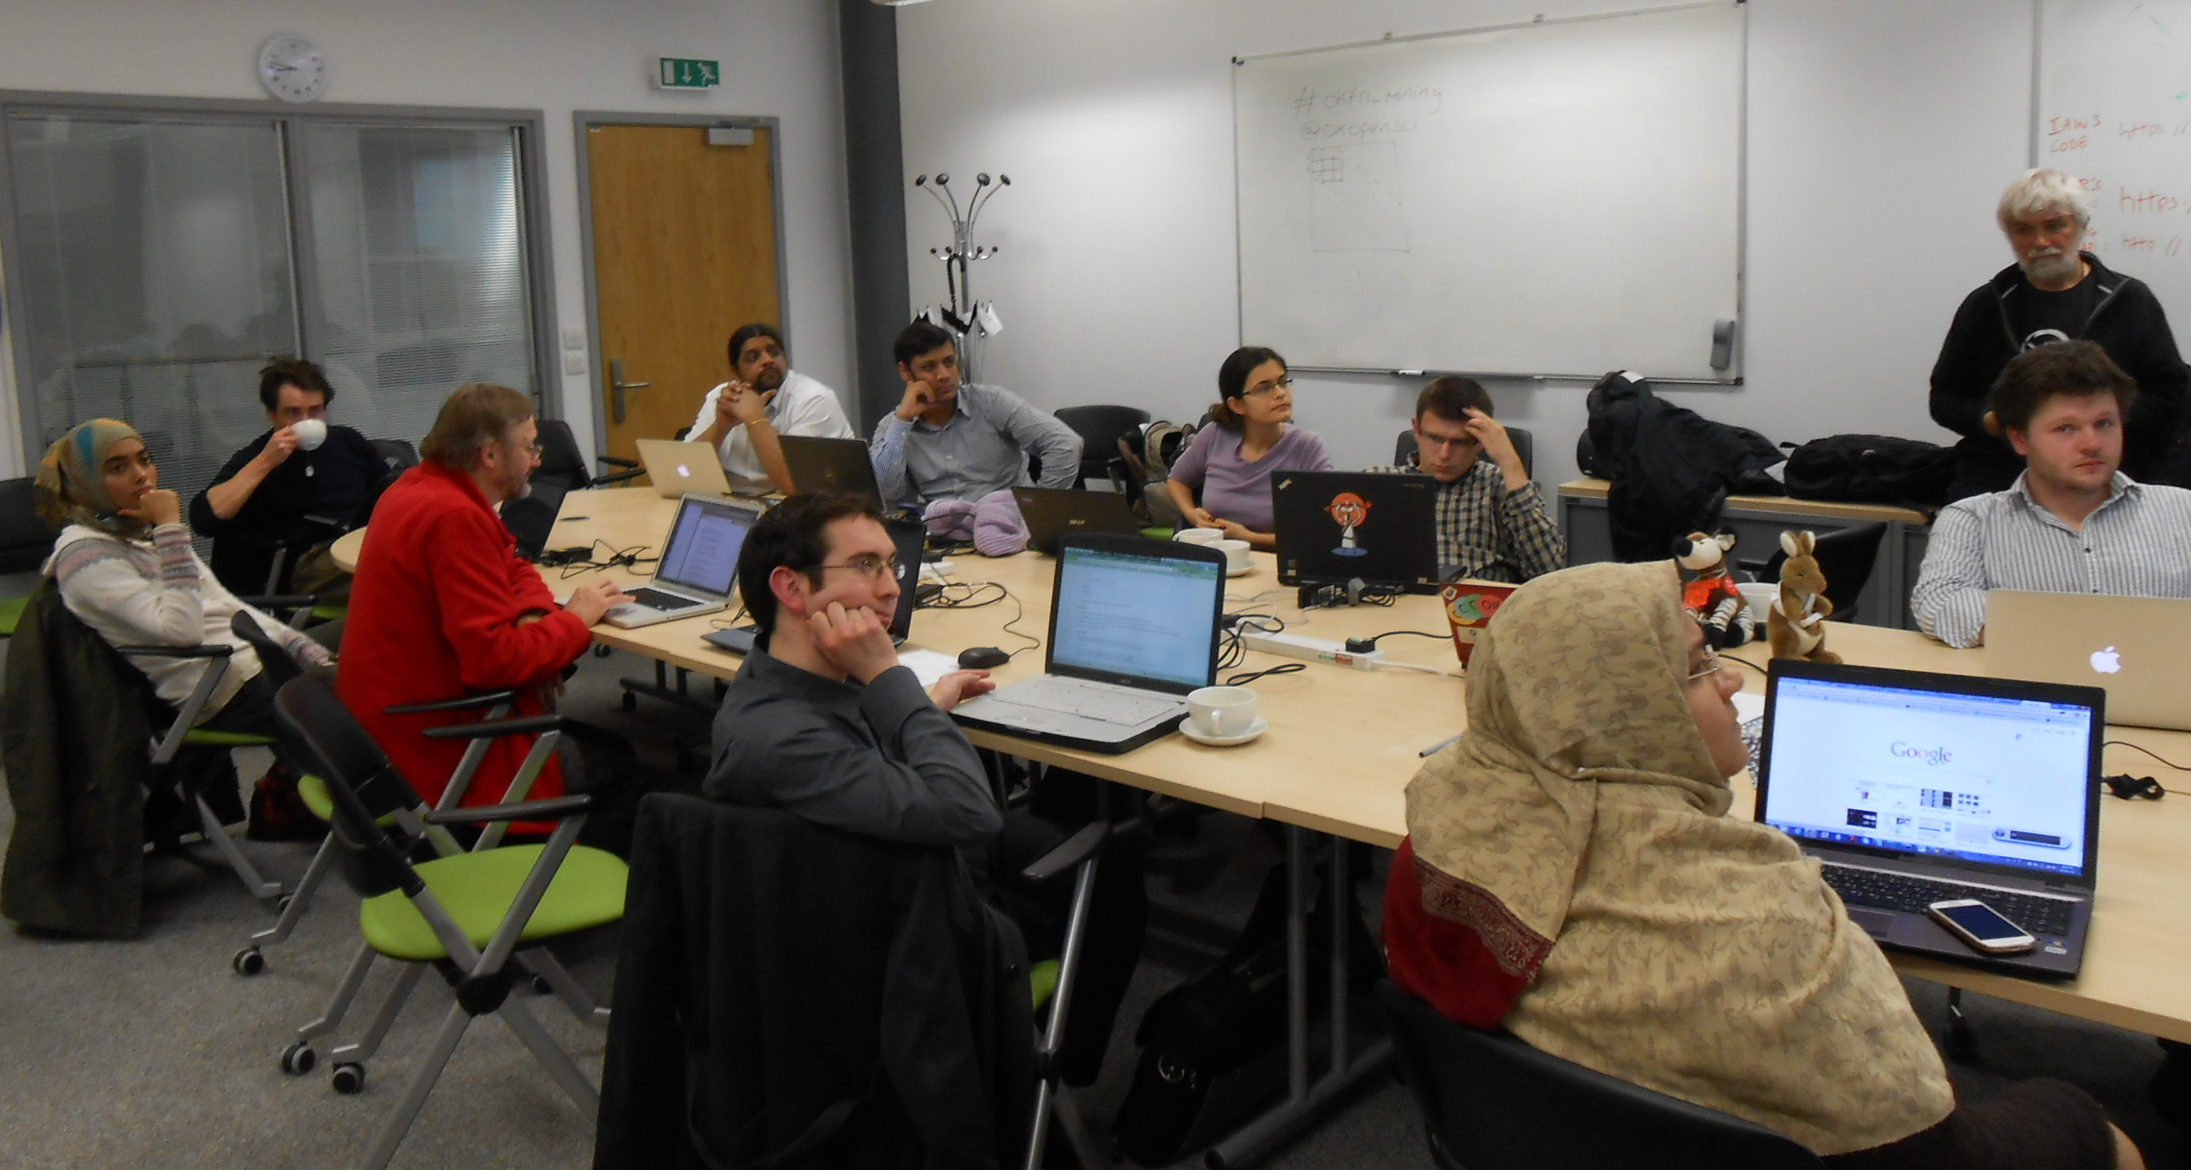
Berlin 2014
Gita Yadav + colleagues
Delhi 2014
Oxford 2013
Jenny Molloy with mascot AMI

Slide 9
Why Open?
Better
Quicker
Flexible
Inclusive
Preservable
Principled

Slide 10
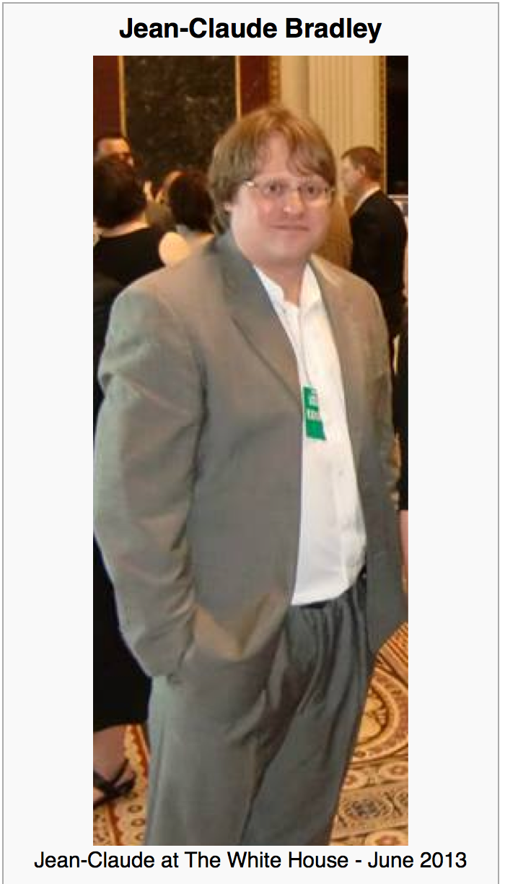

Jean-Claude Bradley
Jean-Claude Bradley was one of the most influential open scientists of our time. He was an innovator in all that he did, from Open Education to bleeding edge Open Science; in 2006, he coined the phrase Open Notebook Science. His loss is felt deeply by friends and colleagues around the world.
On Monday July 14, 2014 we gathered at Cambridge University to honour his memory and the legacy he leaves behind with a highly distinguished set of invited speakers to revisit and build upon the ideas which inspired and defined his life’s work.
Wikipedia CC BY-SA
Notes:
Hi, I’m here to talk about AMI; a data extraction framework and tool. First, I just want highlight some of key contributors to the projects; Andy for his work on the ChemistryVisitor and Peter for the overall architecture.
In this talk, I’m going to impress the importance of data in a specific format and its utility to automated machine processing. Then I’m going to demonstrate AMI’s architecture and the transformation of data as it flows through the process. I’m going to dwell a little on a core format used, Scalable Vector Graphics (SVG) before introducing the concept of visitors, which are pluggable context specific data extractors. Next, I’m going to introduce Andy’s ChemVisitor, for extracting semantic chemistry data, along with a few other visitors that can process non-chemistry specific data. Finally, I will demonstrate some uses of the ChemVisitor, within the realm of validation and metabolism.

Slide 11
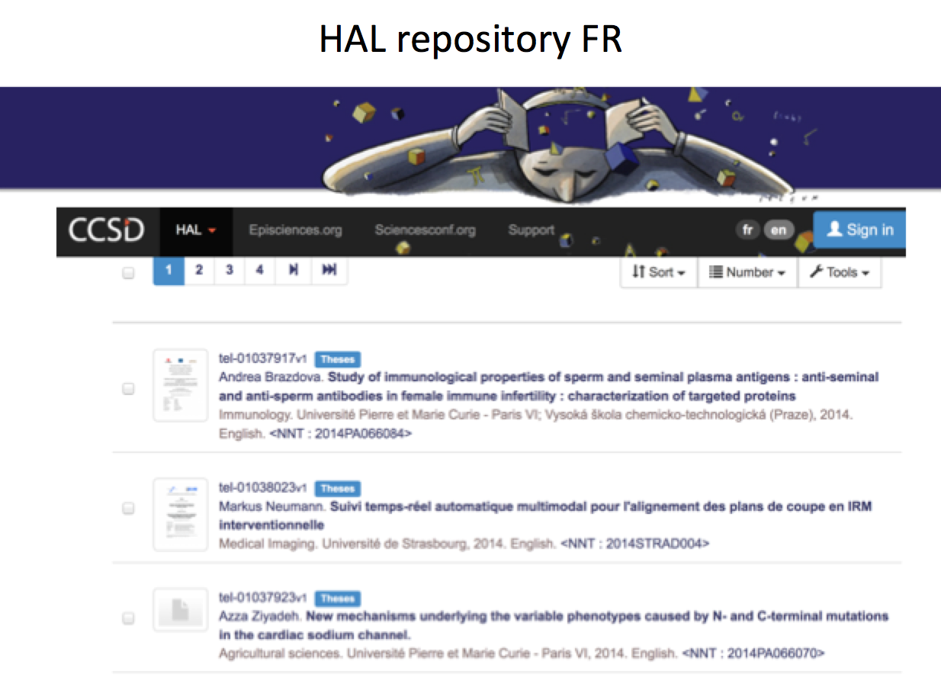
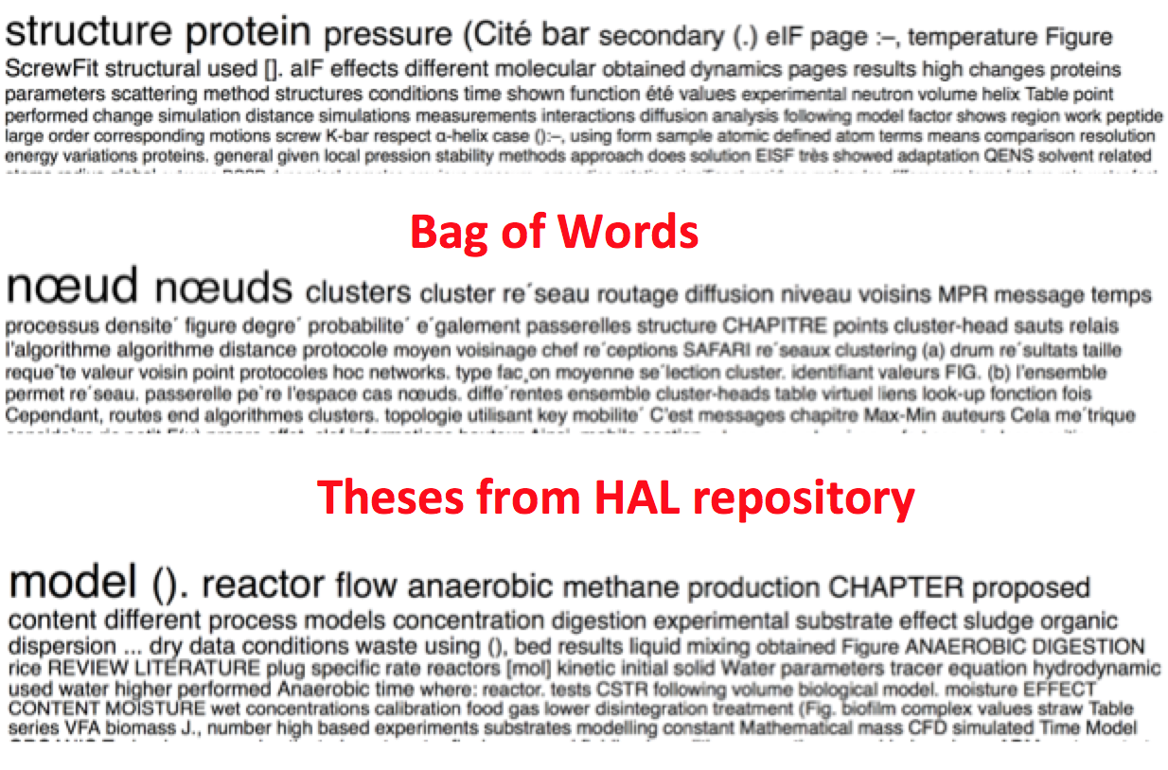
Value and use your thesis!
2018-03-18 Amelia Hunt (final year hons Edinburgh) researching Open Notebook Science by interviewing PMR and other practitioners. Dissertation will be deposited in Repository under Open licence.

Slide 12
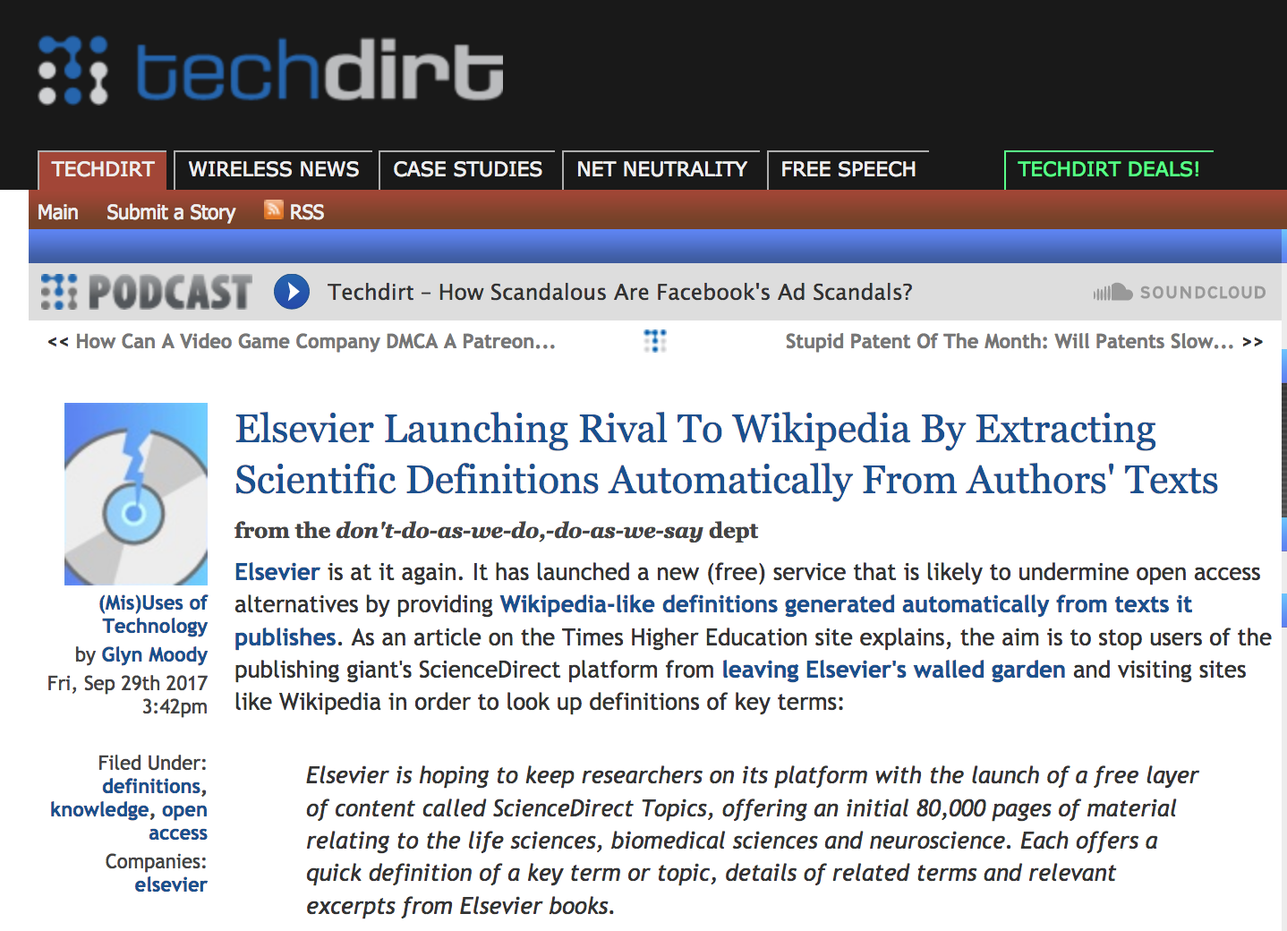

Slide 13
The Publisher-Academic complex[1]
$$, MS
review
Taxpayer
$$
$$
Publishers
Academia
Student
Glory+?
in-kind
Infrastructure
Researcher
“The scholarly poor”
[1] The Military-Industrial-Academic complex (1961)
(Dwight D Eisenhower, US President)

Slide 14
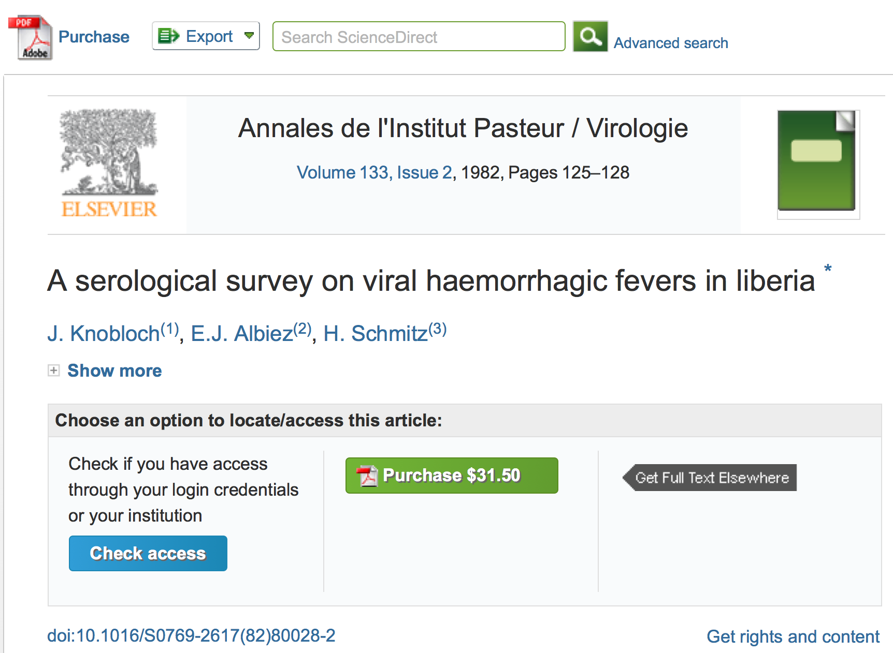
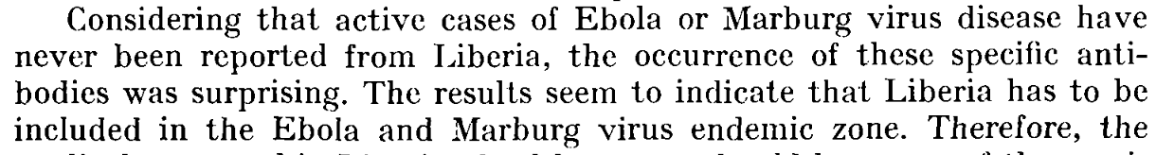

Slide 15
A System Failure of Scholarly Publishing
http://www.nytimes.com/2015/04/08/opinion/yes-we-were-warned-about-ebola.html
We were stunned recently when we stumbled across an article by European researchers in Annals of Virology [1982]: “The results seem to indicate that Liberia has to be included in the Ebola virus endemic zone.” In the future, the authors asserted, “medical personnel in Liberian health centers should be aware of the possibility that they may come across active cases and thus be prepared to avoid nosocomial epidemics,” referring to hospital-acquired infection.
Adage in public health: “The road to inaction is paved with research papers.”
Bernice Dahn (chief medical officer of Liberia’s Ministry of Health)
Vera Mussah (director of county health services)
Cameron Nutt (Ebola response adviser to Partners in Health)

Slide 16

Scholarly publishing is “Big Data”
1 year’s scholarly output!
$500 Billion public research => 2.5 million articles /year , 7000 /day
Most is not Publicly readable and much is unused
ContentMining (TDM) can liberate knowledge
Many mega-publishers fight ContentMining
[1] http://www.crossref.org/01company/crossref_indicators.html
[2] https://en.wikipedia.org/wiki/Mont_Blanc#/media/File:Mont_Blanc_depuis_Valmorel.jpg

Slide 17
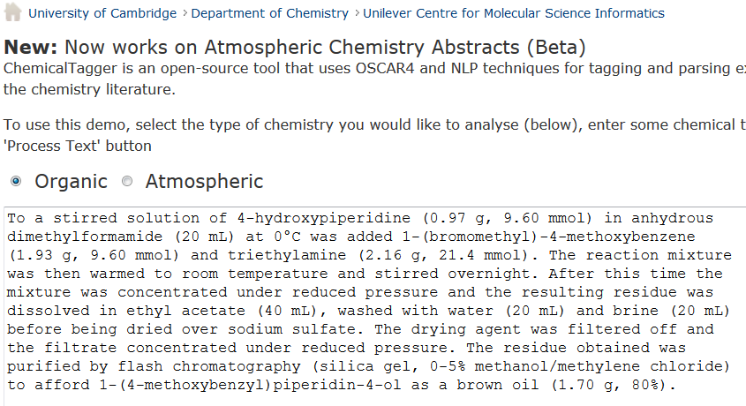
http://chemicaltagger.ch.cam.ac.uk/
Typical
Typical chemical synthesis

Slide 18
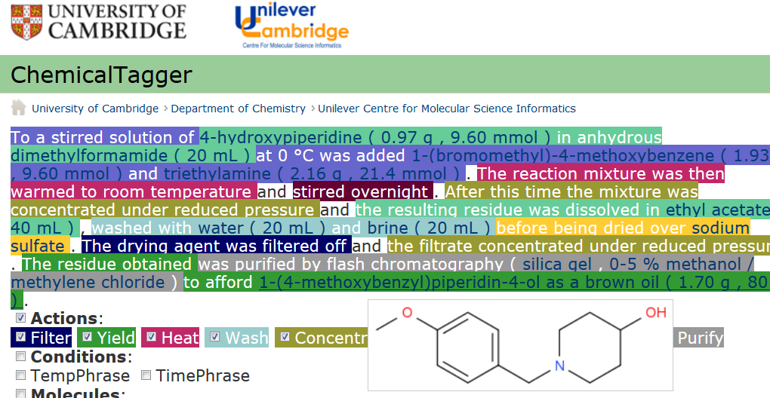
Automatic semantic markup of chemistry
Could be used for analytical, crystallization, etc.

Slide 19
http://www.budapestopenaccessinitiative.org/read
… an unprecedented public good. …
… completely free and unrestricted access to [peer-reviewed literature] by all scientists, scholars, teachers, students, and other curious minds. …
…Removing access barriers to this literature will accelerate research, enrich education, share the learning of the rich with the poor and the poor with the rich, make this literature as useful as it can be, and lay the foundation for uniting humanity in a common intellectual conversation and quest for knowledge.
(Budapest Open Access Initiative, 2003)

Slide 20
BENEFITS OF CONTENT MINING
Hague Declaration 2015
Addressing grand challenges such as climate change and global epidemics
Improving population health, wealth and development
Creating new jobs and employment
Exponentially increasing the speed and progress of science through new insights and greater efficiency of research
Increasing transparency of governments and their actions
Fostering innovation and collaboration and boosting the impact of open science
Creating tools for education and research
Providing new and richer cultural insights
Speeding economic and social development in all parts of the globe

Slide 21
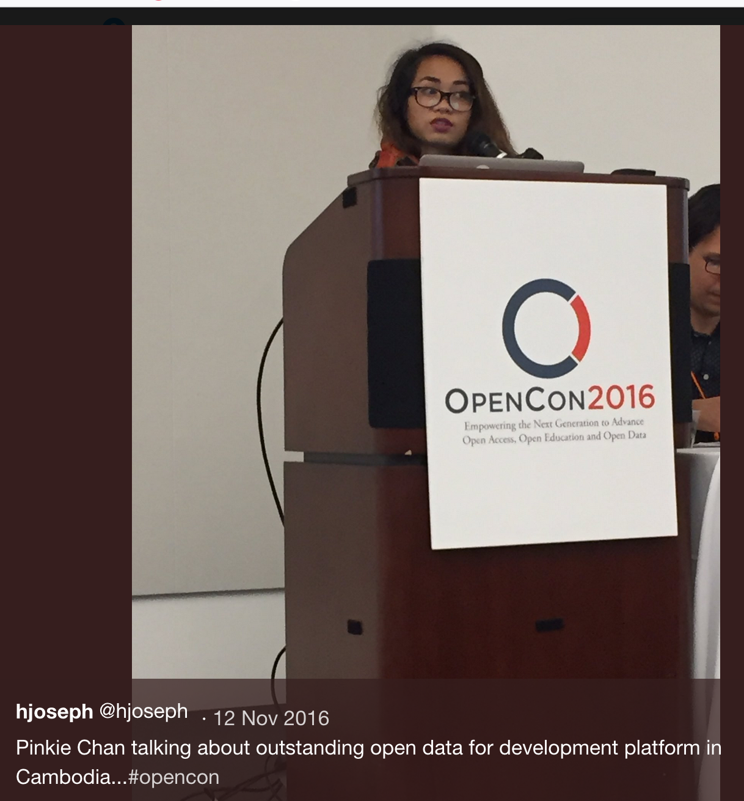
PMR’s Shuttleworth Flash Grantees
Erin McKiernan (Opencon)
Daniel Mietchen (Wikimedian)
Joe McArthur (Right to Research)
Chris Hartgerink (Opencon)
Pinkie Chan* (Fighting land grabs in Cambodia w OpenData)
Heather Piwowar (Impact Story, Unpaywall)
Corina Logan (Bullied into Bad Science)

Slide 22
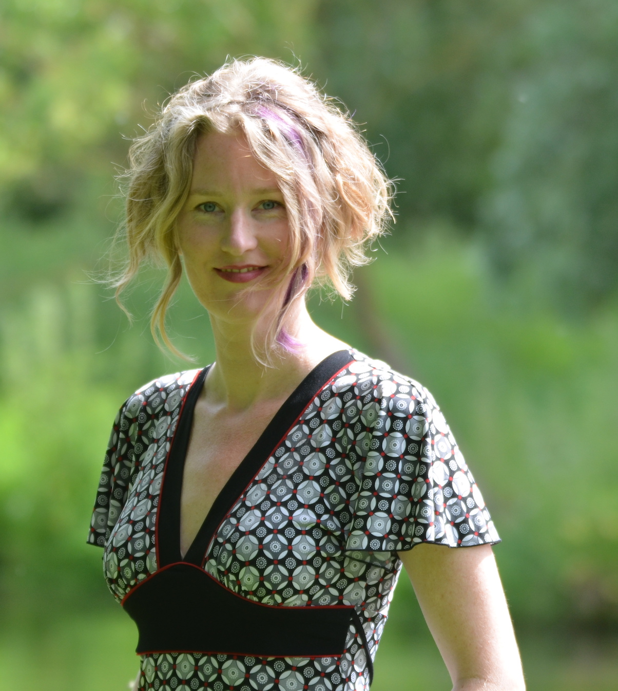
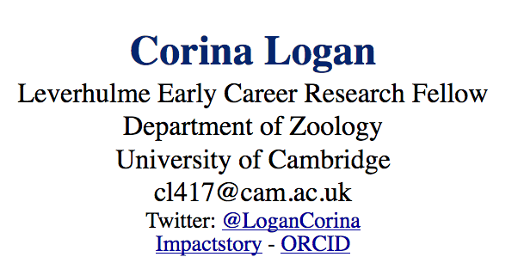
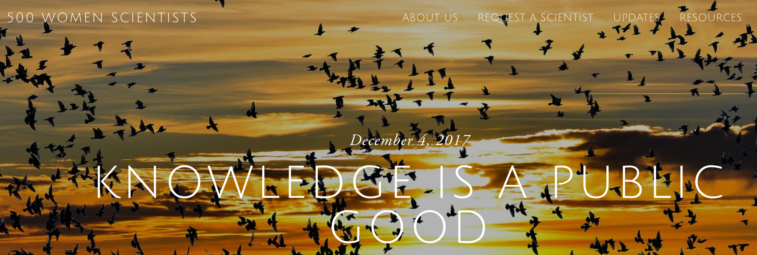
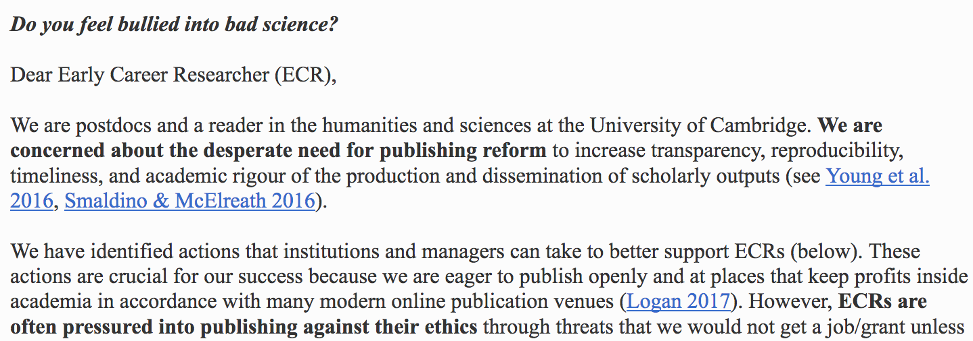
KNOWLEDGE IS A PUBLIC GOOD

Slide 23
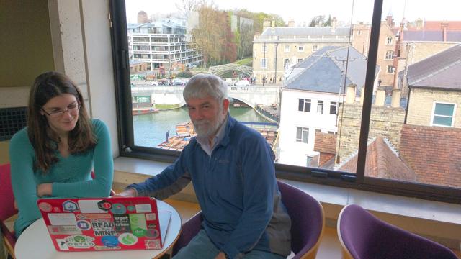
https://www.youtube.com/watch?v=1pGgBZes9Yg&index=5&t=0s&list=PLTdz0WcNX4rdYb4cDyesz7iYchIwMBYlD

Slide 24
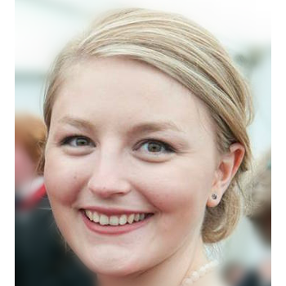
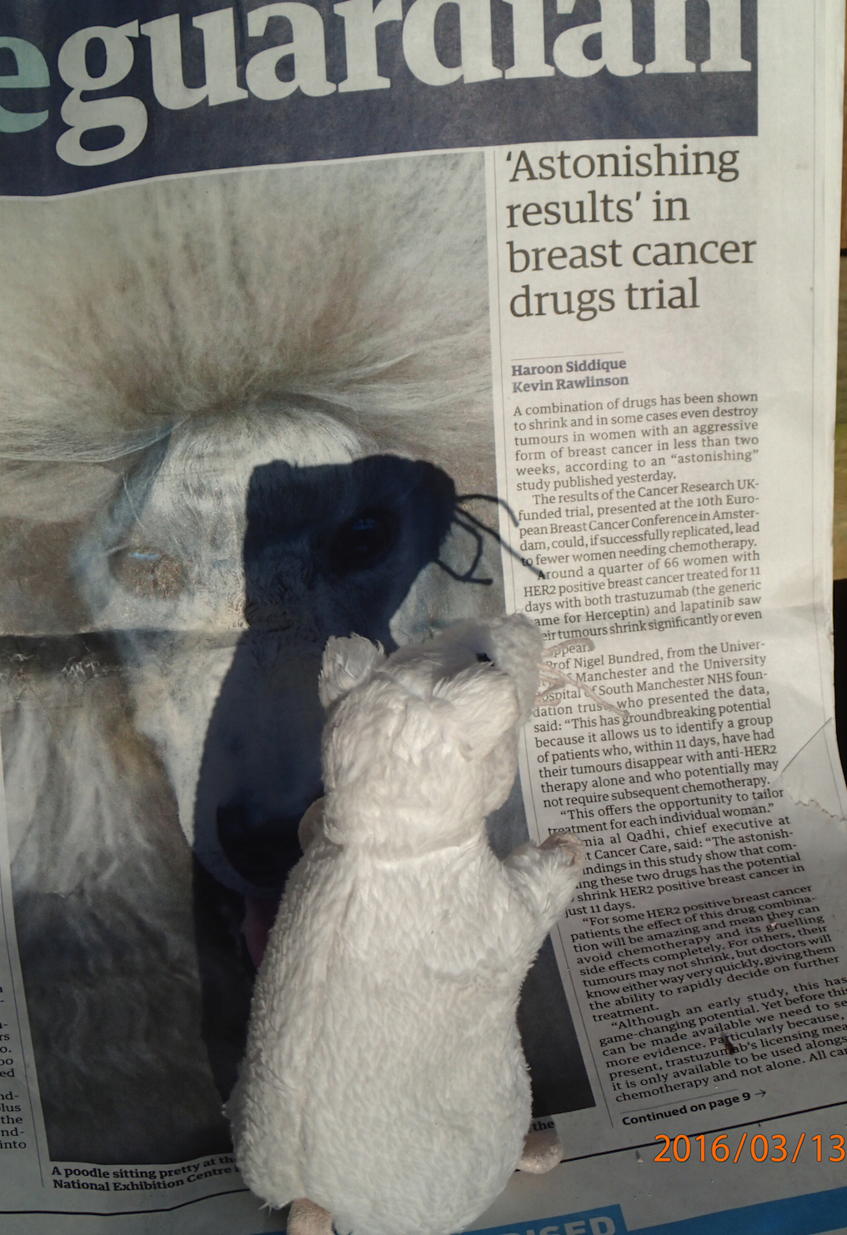
Alexandra Bannach-Brown
Edinburgh, Neuroscience
Problem: huge body of works in animal studies about depressions. systematic review is the main approach for getting insight.
Wants: identify papers in systematic review of depressive behaviour in animals. What drugs, what methods, what outcomes and signs/phenotypes. Use outcomes for document clustering.
and expedite scientific advances."
Corpus: 70.000 Papers

Slide 25
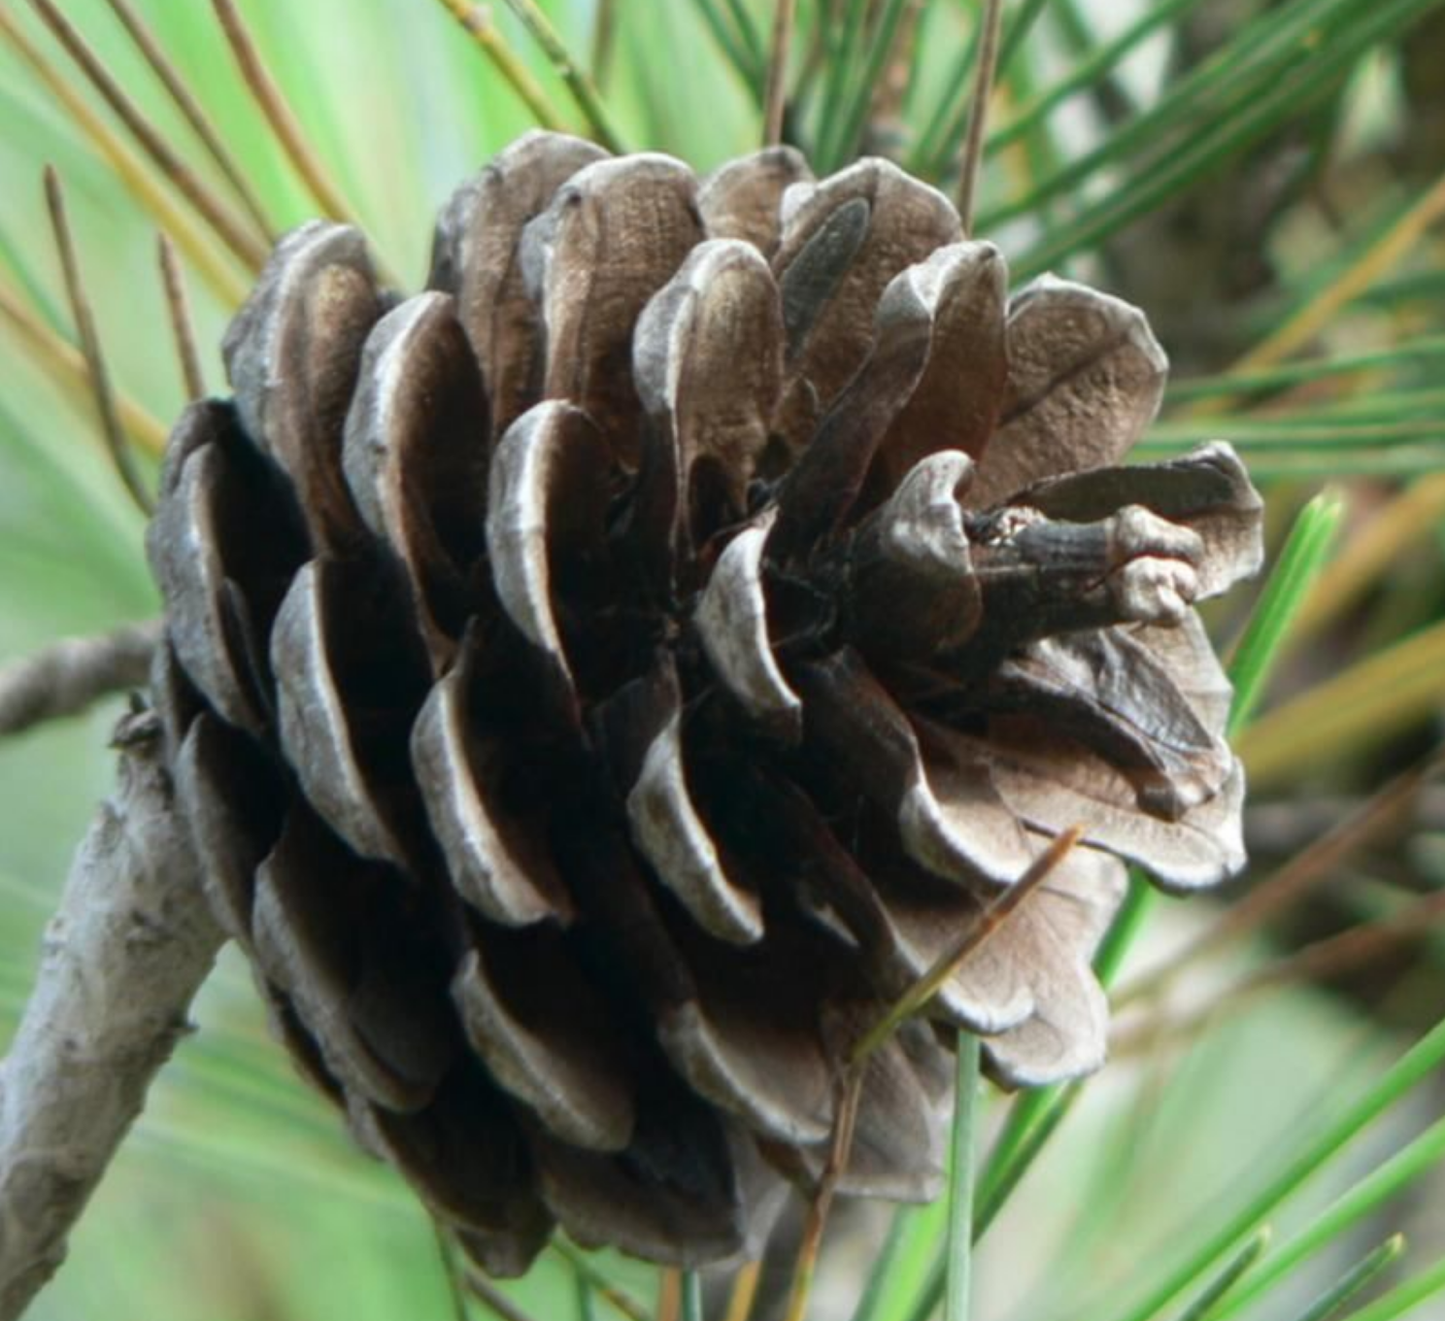

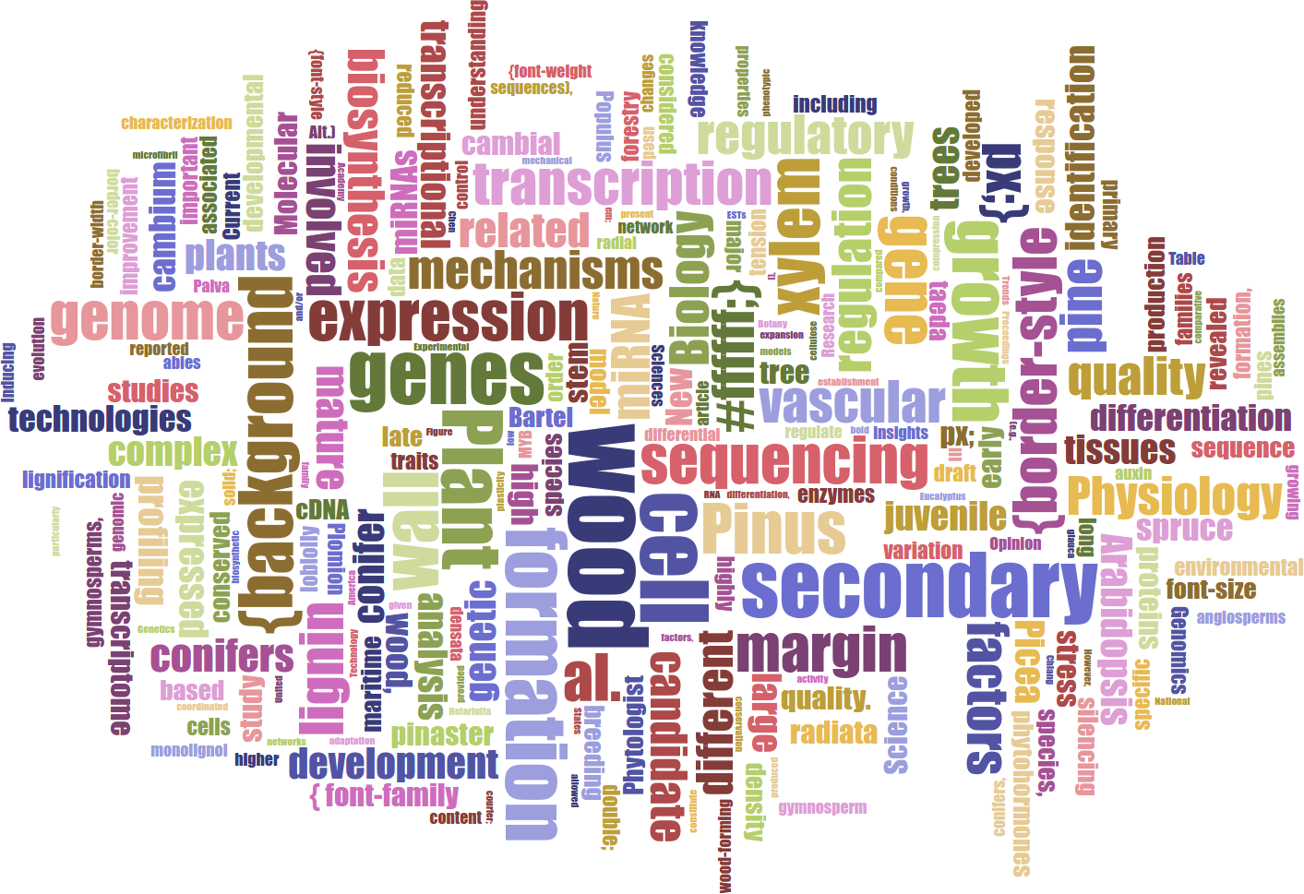
Lars Willighagen
15 years old NL
Wants: extract data about conifers (relations to chemicals, height etc.)
Outcome: database with webpage containing conifer properties
Table Facts Visualiser DEMO
Card DEMO
Word Cloud
„ I applied to this fellowship to learn new things and combine the ContentMine with two previous projects I never got to finish, and I got really excited by the idea and the ContentMine at large.“

Slide 26
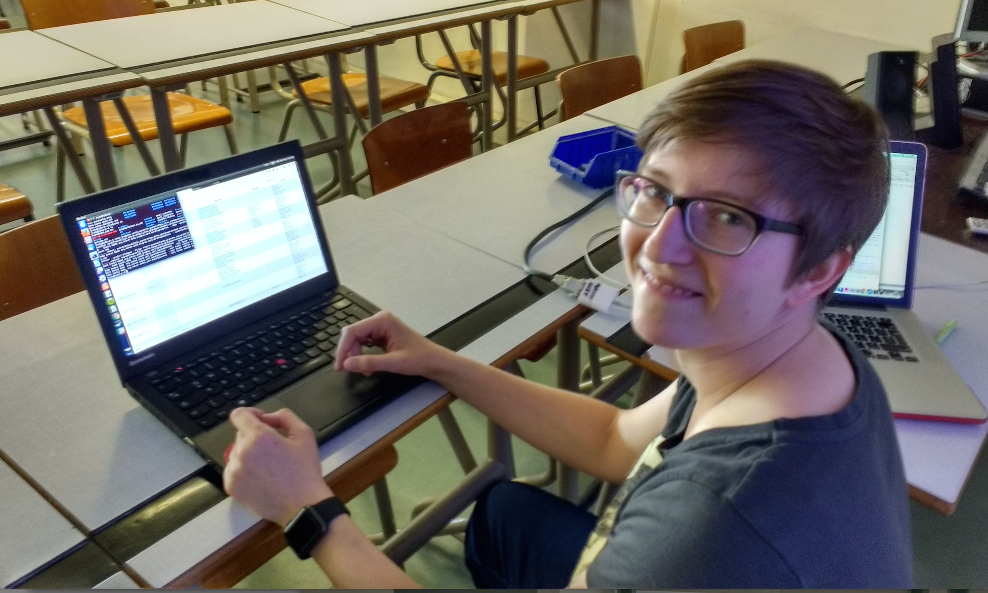
Felix Reda, Pirate MEP, running ContentMine software to liberate science 2016-04-16

Slide 27
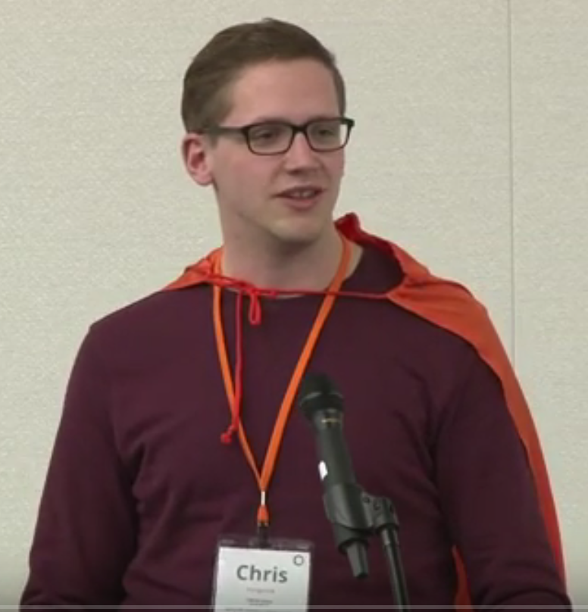
Chris Hartgerink
Tilburg University (NL)
Reproducible Science
Extracting statistical information
Helping authors check
reported results
Detecting problematic study
results (e.g., clinical trials)

Slide 28
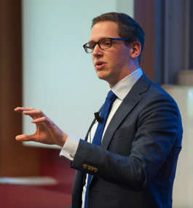
Elsevier stopped me doing my research
Chris Hartgerink
@Senficon (Felix Reda) :Text & Data mining in times of #copyright maximalism:
"Elsevier stopped me doing my research" http://onsnetwork.org/chartgerink/2015/11/16/elsevier-stopped-me-doing-my-research/ … #opencon #TDM

Slide 29
Panton Principles for Open Data in science(2010)
PUBLISH YOUR DATA OPENLY
…make an explicit and robust statement of your wishes.
Use a recognized waiver or license that is appropriate for data.
open as defined by the Open Knowledge/Data Definition (… NOT non-commercial)
Explicit dedication of data … into the public domain via PDDL or CCZero
Peter Murray-Rust, Cameron Neylon, Rufus Pollock, John Wilbanks

Slide 30
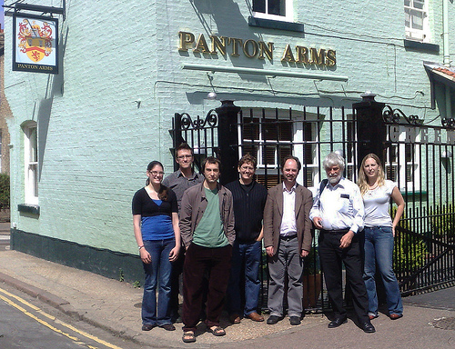
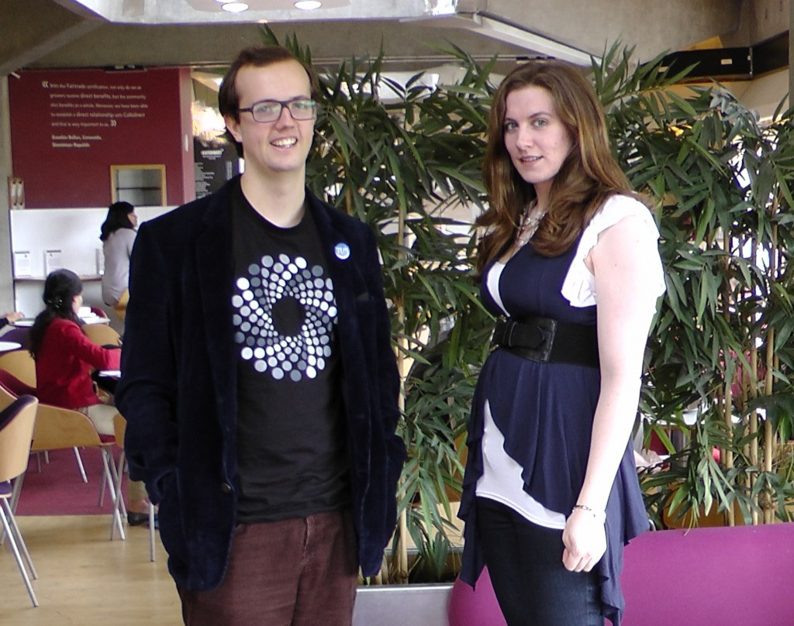
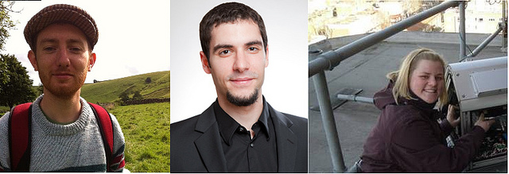
Panton Authors and Fellows

Slide 31
The Hague Declaration on Knowledge Discovery in the Digital Age (2015)
INTELLECTUAL PROPERTY WAS NOT DESIGNED TO REGULATE THE FREE FLOW OF FACTS, DATA AND IDEAS, BUT HAS AS A KEY OBJECTIVE THE PROMOTION OF RESEARCH ACTIVITY
PEOPLE SHOULD HAVE THE FREEDOM TO ANALYSE AND PURSUE INTELLECTUAL CURIOSITY WITHOUT FEAR OF MONITORING OR REPERCUSSIONS
LICENSES AND CONTRACT TERMS SHOULD NOT RESTRICT INDIVIDUALS FROM USING FACTS, DATA AND IDEAS
ETHICS AROUND THE USE OF CONTENT MINING TECHNIQUES WILL NEED TO CONTINUE TO EVOLVE IN RESPONSE TO CHANGING TECHNOLOGY
INNOVATION AND COMMERCIAL RESEARCH BASED ON THE USE OF FACTS, DATA, AND IDEAS SHOULD NOT BE RESTRICTED BY INTELLECTUAL PROPERTY LAW
http://thehaguedeclaration.com/the-hague-declaration-on-knowledge-discovery-in-the-digital-age/
Drafted 2014-12 , convened by LIBER (Association of European Research Libraries)

Slide 32
Summary
Use knowledge to fight injustice
Collaborate
Don’t be afraid to ask! Or innovate…
Blog/tweet/video relentlessly
Be true to your values

Slide 33
Copyright Problems
By default Copyright forbids everything until proved otherwise.
Clear answers are often only available when you defend yourself in court
Language is not precise.
“non-commercial”
“fair redistribution”
“public interest research organization”
Scientific Researchers using mining live in a constant state of Fear-Uncertainty-Doubt.
Legal reform is a necessary but not sufficient solution.

Slide 34
Surveillance Capitalism Snoop and Control

Slide 35
See also:
https://github.com/petermr/CEVOpen/blob/master/INYAS_presentation_2021/ayush_inyas.pdf
Thanks to: * Yusuf Hamied Travel Fellowship (Cambridge India)
NIPGR Hosting and internships
Indian National Young Academy of Scientists
The brave people who have challenged injustice

